Slide 1
British Summer Championships 2022
Team Leader Meeting
21st July 2022

Slide 2
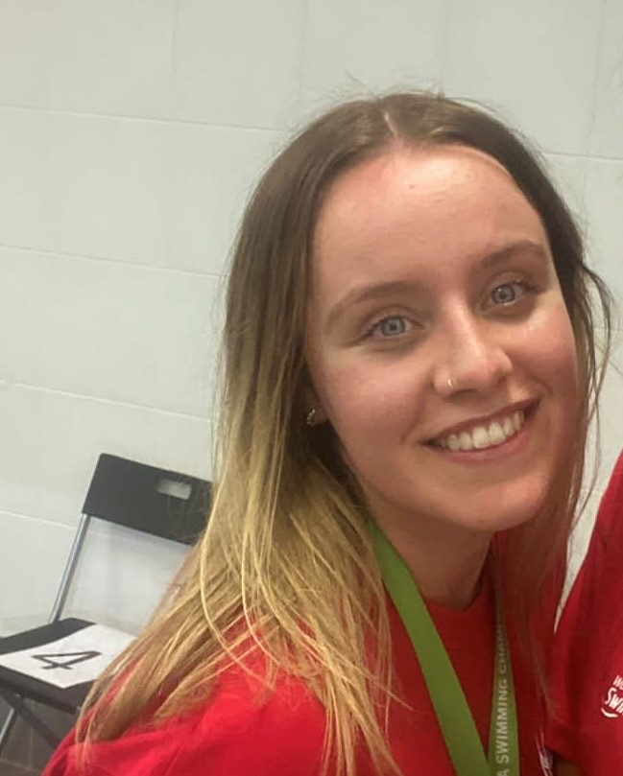
Isobel Griffiths
Events & Partnerships Officer

Slide 3
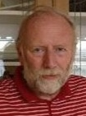
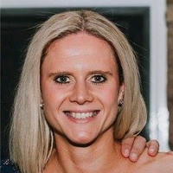
Barry Saunders & Kim Bligh
Meet Directors

Slide 4
4
Team Staff
British Summer Championships 2022
Technical Director David Downie
Chief Recorder Ray Gordon
Sports Presentation Rachel Washington –
Alan March Sport

Slide 5
5
Accreditation
British Summer Championships 2022
Accreditation must be worn at all times and Coaches & Swimmers will not be able to access the building without it.
Lost or mislaid report to the British Swimming Front Desk with £10

Slide 6
6
Covid 19
British Summer Championships 2022
The Confirmation Pack includes guidance to all athletes entered in the meet.
Consider wearing a face covering especially in crowded or enclosed spaces
If you have any of the following symptoms the government advises you to stay at home.
A new continuous cough, high temperature or loss, or change in, your normal sense of taste or smell
Wash your hands with soap and water or use hand sanitizer regularly throughout the day.

Slide 7
7
Training & Warm Up
British Summer Championships 2022
We have to operate within the SOP for Ponds Forge. This means that we are restricted in the number of swimmers allowed in the pool at any one time.
Hence why you have had to book training slots and sessions have had to be split by age group to keep within the numbers for a Warm Up.

Slide 8
8
Pool Layout
British Summer Championships 2022

Slide 9
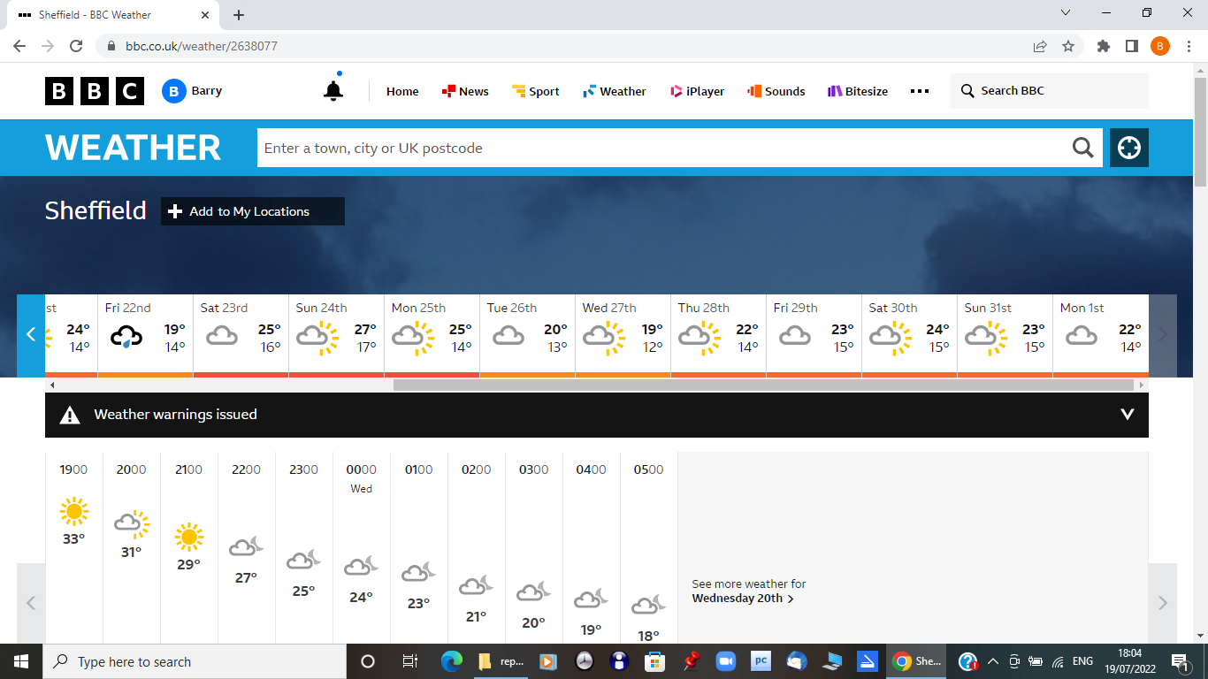
9
Local Weather
British Summer Championships 2022
Its going to be milder than normal
Bottles of Water and a Refill station
Ice available at Café all the time it is open

Slide 10
10
Structure of Meet
22nd July 2022
British Summer Championships 2022
On Day one, Friday 22nd July the Men’s 1500m Freestyle will be swum in the morning starting at 8-15am.
This will immediately be followed by the Women’s 1500m Freestyle.
All the 4x200m Freestyle teams will be swum late afternoon/early evening
All these events will be H.D.W.

Slide 11
11
Structure of Meet
23rd – 28th July
British Summer Championships 2022
17 & over, Para Swimmers, and the Men’s & Women’s 800m Freestyle will be swum in the morning session which will start at 8-30am
13 – 16 year old swimmers will swim in the 2nd Heat Sessions of the day. These have a variable start time.
All 4x100m Team Events will be swum in a further session in the afternoon

Slide 12
12
TV & Media
British Summer Championships 2022
This event will be live streamed.
Try to ensure that swimmers use the changing rooms to get changed – not the pool
deck please.
We will be operating a clear deck on the Omega side of the pool.

Slide 13
13
British Summer Championships 2022
Friday 22nd July
HEATS
Warm Up: 7-35am Start: 8:15am Men’s 1500m Freestyle H.D.W.
Warm Up: 11-30am Start: 12-10pm Women’s 1500m Freestyle H.D.W
Teams Warm Up: 3-45pm Start: 4-25pm Men’s 14/16 4x200m Free H.D.W. Men’s 17+ 4x200m Free H.D.W. Warm Up: 5-30pm Start: 6-10pm Women’s 14/16 4x200m Free H.D.W. Women’s 17+ 4x200m Free H.D.W.
TRAINING
Start 7-15pm

Slide 14
14
British Summer Championships 2022
Saturday 23rd July
HEATS
17 & over + MC Warm Up: 7-15am – Men’s 7-50am - Women’s Start: 8-30am – 11-05am
Men’s 400m Freestyle, Women’s MC 200m Freestyle Men’s MC 200m Freestyle, Women’s 200m Freestyle Men’s 100m Breaststroke, Women’s MC 400m Freestyle Men’s MC 400m Freestyle, Women’s 400m Ind. Medley Men’s 50m Backstroke, Women’s 50m Breaststroke Men’s MC 150m Ind. Medley, Women’s MC 150m Ind. Medley
13-16 years Warm Up: 11-45am – Men’s 12-20pm - Women’s Start: 1pm – 3-35pm
Men’s 400m Freestyle, Women’s 200m Freestyle Men’s 100m Breaststroke, Women’s 400m Ind. Medley Men’s 50m Backstroke, Women’s 50m Breaststroke

Slide 15
15
Sunday 24th July
HEATS
British Summer Championships 2022
17 & over, Women’s 800m Free + MC
Warm Up: 7-15am – Men’s
7-50am - Women’s
Start: 8-30am – 12noon
Men’s 200m Butterfly, Women’s 100m Backstroke
Women’s MC 100m Backstroke, Men’s MC 100m Backstroke
Men’s 100m Backstroke, Women’s 200m Breaststroke
Women’s MC 50m Butterfly, Men’s MC 50m Butterfly
Men’s 50m Breaststroke, Women’s 800m Freestyle H.D.W.
13-16 years
Warm Up: 12-30pm – Men’s
1-05pm - Women’s
Start: 1-45pm – 3-25pm
Men’s 200m Butterfly, Women’s 100m Backstroke
Men’s 100m Backstroke, Women’s 200m Breaststroke
Men’s 50m Breaststroke

Slide 16
16
Monday 25th July
HEATS
British Summer Championships 2022
17 & over + MC
Warm Up: 7-15am – Women’s
7-50am - Men’s
Start: 8-30am – 10-15am
Women’s MC 100m Freestyle, Men’s MC 100m Freestyle
Women’s 200m Butterfly, Men’s 100m Freestyle
Women’s MC 100m Breaststroke, Men’s MC 100m Breaststroke
Women’s 50m Freestyle, Men’s 400m Individual Medley
Women’s MC 50m Breaststroke, Men’s MC 50m Breaststroke
13-16 years
Warm Up: 10-45am – Women’s
11-20am- Men’s
Start: 12noon – 1-35pm
Women’s 200m Butterfly, Men’s 100m Freestyle
Women’s 50m Freestyle, Men’s 400m Individual Medley
Teams
Warm Up: 1-35pm
Start: 2-15pm – 2-50pm
Women’s 14/16 4x100m Medley, Women’s 17+ 4x100m Medley

Slide 17
17
Tuesday 26th July
HEATS
British Summer Championships 2022
17 & over + MC Warm Up: 7-15am – Women’s 7-50am – Men’s Start: 8-30am – 10-15am
Women’s 100m Freestyle, Men’s 200m Breaststroke Men’s MC 200m Ind. Medley, Women’s MC 200m Ind. Medley Women’s 200m Backstroke, Men’s 100m Butterfly Men’s MC 50m Freestyle, Women’s MC 50m Freestyle Women’s 50m Butterfly
13-16 years Warm Up: 10-45am – Women’s 11-20am- Men’s Start: 12noon – 1-35pm
Women’s 100m Freestyle, Men’s 200m Breaststroke Women’s 200m Backstroke, Men’s 100m Butterfly Women’s 50m Butterfly
Teams Warm Up: 1-35pm Start: 2-15pm – 2-45pm Men’s 14/16 4x100m Medley, Men’s 17+ 4x100m Medley

Slide 18
18
Wednesday 27th July
HEATS
British Summer Championships 2022
17 & over, Men’s 800m Free + MC Warm Up: 7-15am – Women’s 7-50am - Men’s Start: 8-30am – 12-10pm
Women’s 400m Freestyle, Men’s 200m Ind. Medley Women’s MC 100m Butterfly, Men’s MC 100m Butterfly Women’s 200m Ind. Medley, Men’s 50m Freestyle Women’s 50m Backstroke, Men’s MC 50m Backstroke Women’s MC 50m Backstroke, Men’s 800m Freestyle H.D.W.
13-16 years Warm Up: 12-30pm – Women’s 1-05pm – Men’s: 1-45pm – 3-45pm
Women’s 400m Freestyle, Men’s 200m Ind. Medley Women’s 200m Ind. Medley, Men’s 50m Freestyle Women’s 50m Backstroke

Slide 19
19
Thursday 28th July
HEATS
British Summer Championships 2022
17 & over Warm Up: 7-15am – Men’s 7-50am – Women’s Start: 8-30am – 9-50am
Men’s 200m Freestyle, Women’s 100m Breaststroke Men’s 200m Backstroke, Women’s 100m Butterfly Men’s 50m Butterfly
13-16 years Warm Up: 10-15am – Men’s 10-50am - Women’s Start: 11-30am – 1-05pm Men’s 200m Freestyle, Women’s 100m Breaststroke Men’s 200m Backstroke, Women’s 100m Butterfly Men’s 50m Butterfly Teams Warm Up: 1pm – Men’s 1-35pm - Women’s Start: 2-15pm – 3-15pm Men’s 14/16 4x100m Free, Men’s 17+ 4x100m Free Women’s 14/16 4x100m Free, Women’s 17+ 4x100m

Slide 20
20
Pool Configuration
British Summer Championships 2022
For all Heats and Finals we will be using Lanes 0-9
As swimmers look down the pool from the Scoreboard end Lane 0 will be to their right
Seeding will be in accordance with FINA Swimming Rule SW3.1 with the exception of the 800/1500m Events which will be spearheaded.

Slide 21
21
Coaches Kiosk/Sport Information Desk
British Summer Championships 2022
Coaches information will be at the Reception Desk in the Foyer.
Start sheets will be available here prior to the start of each session, along with results sheets and team leader timelines.
Swimmers and coaches must be aware of all announcements and any notices will be available in the coaches’ kiosk.

Slide 22
22
Training
British Summer Championships 2022
Saturday: 3-40pm – to 4-10pm
Sunday: 3-30pm – 4-05pm
Monday: 3pm – 4-05pm
Tuesday: 3pm – 4-05pm
Wednesday: 3-30pm – 4-05pm
Thursday: 3-30pm – 4-05pm

Slide 23
23
Withdrawal from Heats
BSC 2022
Withdrawals must be made by the end of the Team Leader Meeting for day 1 swims, and by 12 noon on the day before for all subsequent days.
All withdrawals are via an online system
https://withdrawals.sportsys.co.uk/british-summer-championships-2022/

Slide 24
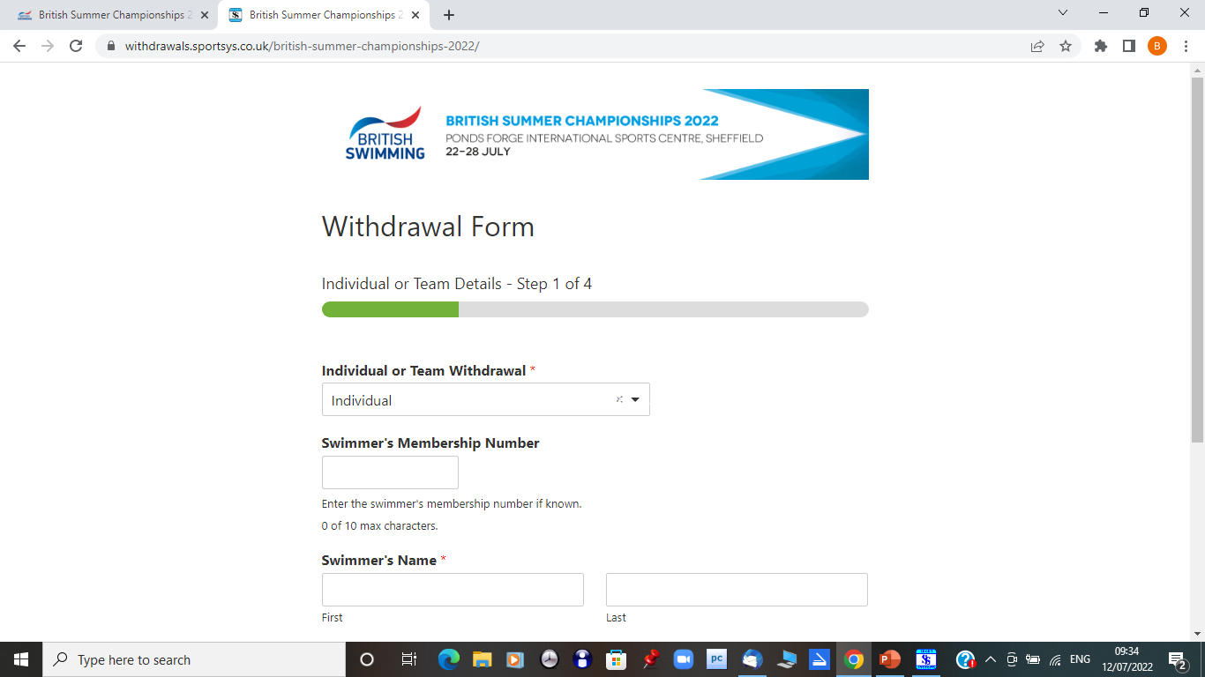

Slide 25
25
Team Events
British Summer Championships 2022
Team Declaration Forms must be completed and submitted to the Recorders at least 60 minutes prior to the start of the session in which the declared swim are to complete
Team Declaration Forms are submitted online.
https://withdrawals.sportsys.co.uk/british-summer-championships-2022-team-declaration/

Slide 26
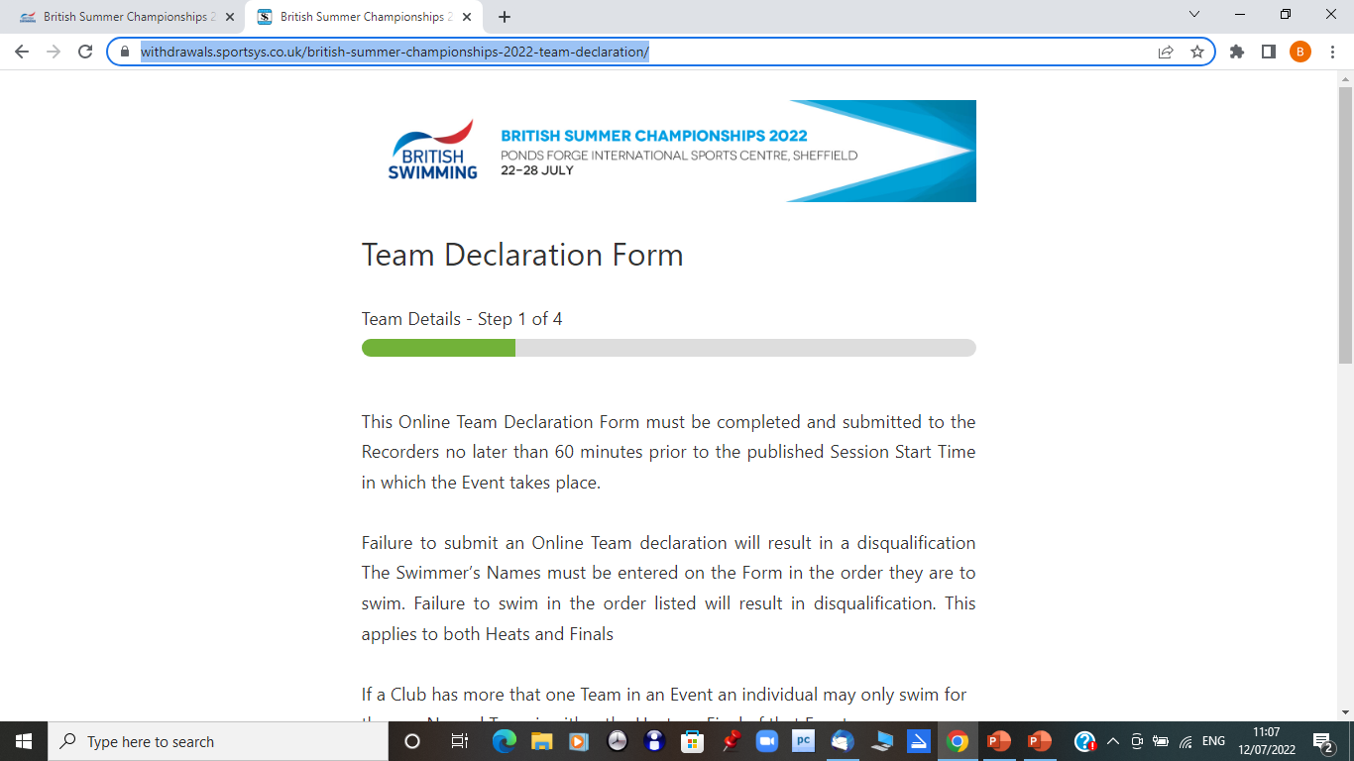
20
Team Events
British Summer Championships 2022

Slide 27
27
Competition Format
British Summer Championships 2022
All competitors will be expected to swim unless the withdrawal procedure has been complied with
INDIVIDUAL EVENTS
Age Groups:
13/14yrs, 15yrs, 16yrs, 17yrs, 18yrs, 19+ yrs
TEAM EVENTS
Age Groups: 14/16yrs, 17+ yrs

Slide 28
Finalists and reserves, not wishing to swim, shall notify the Chief Recorder of their intention to withdraw no later than 30 minutes after the conclusion of the last event in the
Session in which they have qualified for the next round.
28
Para Swimming Events
British Summer Championships 2022
Para events competed on Multi-class basis
Top 10 swimmers as determined by British Para-Swimming Points will progress to the final
Dead Heat of equal points exceeding 10 progressing to a final will require a swim off
Finals seeded by time
There will be a heat and final for all events.

Slide 29
Finalists and reserves, not wishing to swim, shall notify the Chief Recorder of their intention to withdraw no later than 30 minutes after the conclusion of the last event in the
Session in which they have qualified for the next round.
29
Withdrawal from Finals
British Summer Championships 2022
Finalists and reserves, not wishing to swim, shall notify the Chief Recorder of their intention to withdraw no later than 30 minutes after the conclusion of the last event in the Session in which they have qualified for the next round
Reserves will be released upon publication of the finals session start lists.
Once released they do not need to report to the Call Room.

Slide 30
30
Call Room – Heats & Finals
British Summer Championships 2022
Swimmers must report to the competition stewards in the call room for heats and finals and follow their direction.
It is your responsibility to report in good time for your event

Slide 31
31
Call Room
British Summer Championships 2022
They must enter the Call Room ‘race ready’ as under normal circumstances having entered the Call Room they should remain in its confines until lead onto the pool deck for their race.
Upon entry, the athlete must ensure that they report to a Steward and be registered as being present in the Call Room.
Coaches/chaperones will not be allowed in the call room area during the finals at anytime.

Slide 32
32
Finals Timelines
British Summer Championships 2022
Timelines for the Finals Sessions are available at this Meeting.
These show the time a Final is due to start and the suggested Reporting time.
Swimmers need to ensure that they are in the Call Room area in good time.
There are no Presentation Ceremonies during the finals sessions.

Slide 33
33
Doping
British Summer Championships 2022
Unfortunately, despite the best efforts of British Swimming, it has not been possible to secure doping control resource for the British Summer Championships, in the midst of a home Commonwealth Games taking place in Birmingham in the coming weeks and other events making up this packed sporting summer in the UK.
This means that, in the instance that a world record is broken across any event at the British Summer Championships, we would not be in a position to ratify this record and it would not be able to stand as a new world record. All new national, British or European records will stand, though, and would be included on the rankings.
While there are no fixed controls in place for a world record, random control measures will still be expected across the meet.

Slide 34
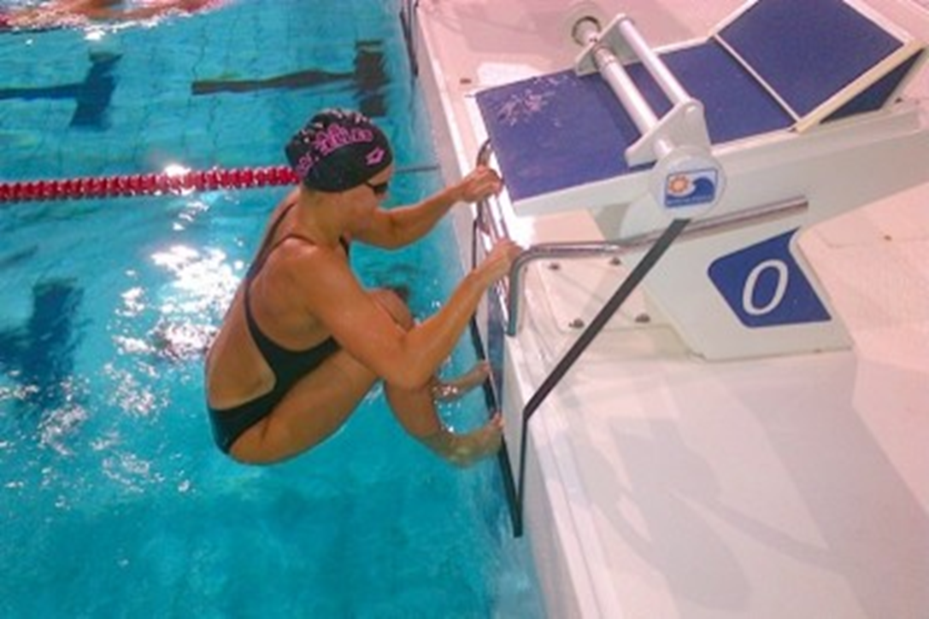
34
Backstroke Ledges
British Summer Championships 2022

Slide 35
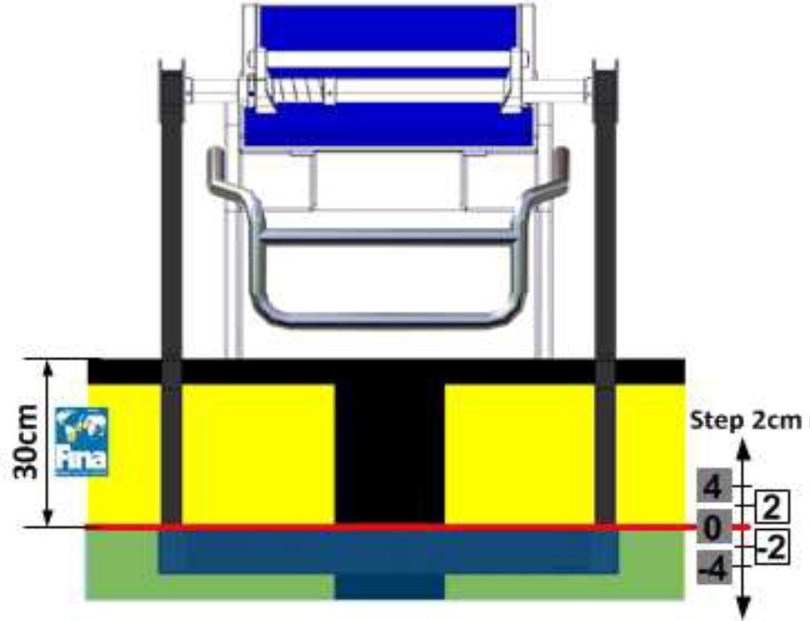
35
Backstroke Ledges
British Summer Championships 2022

Slide 36
Any Questions

