Slide 1
AQUATICS GB SWIMMING CHAMPIONSHIPS 2024

Slide 2
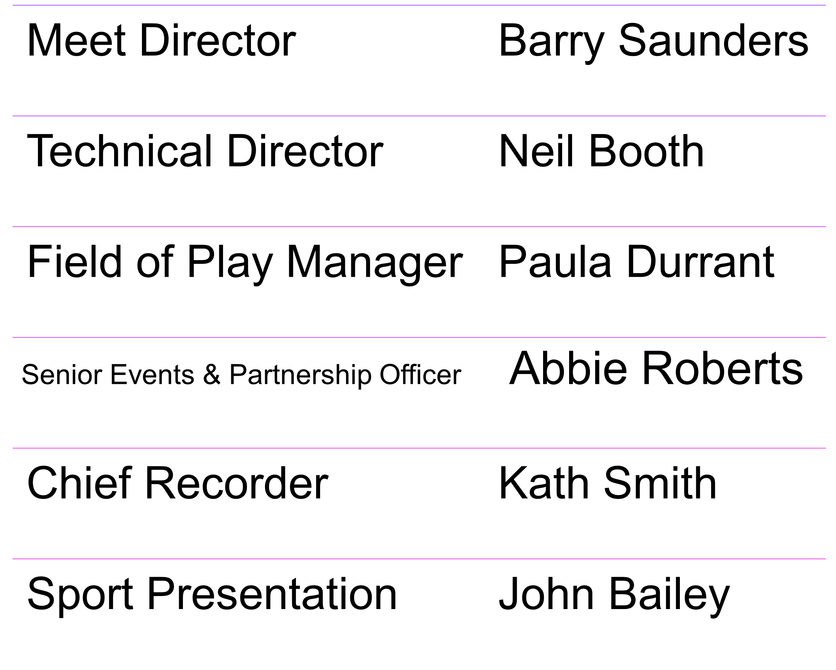
Management team
Management team

Slide 3
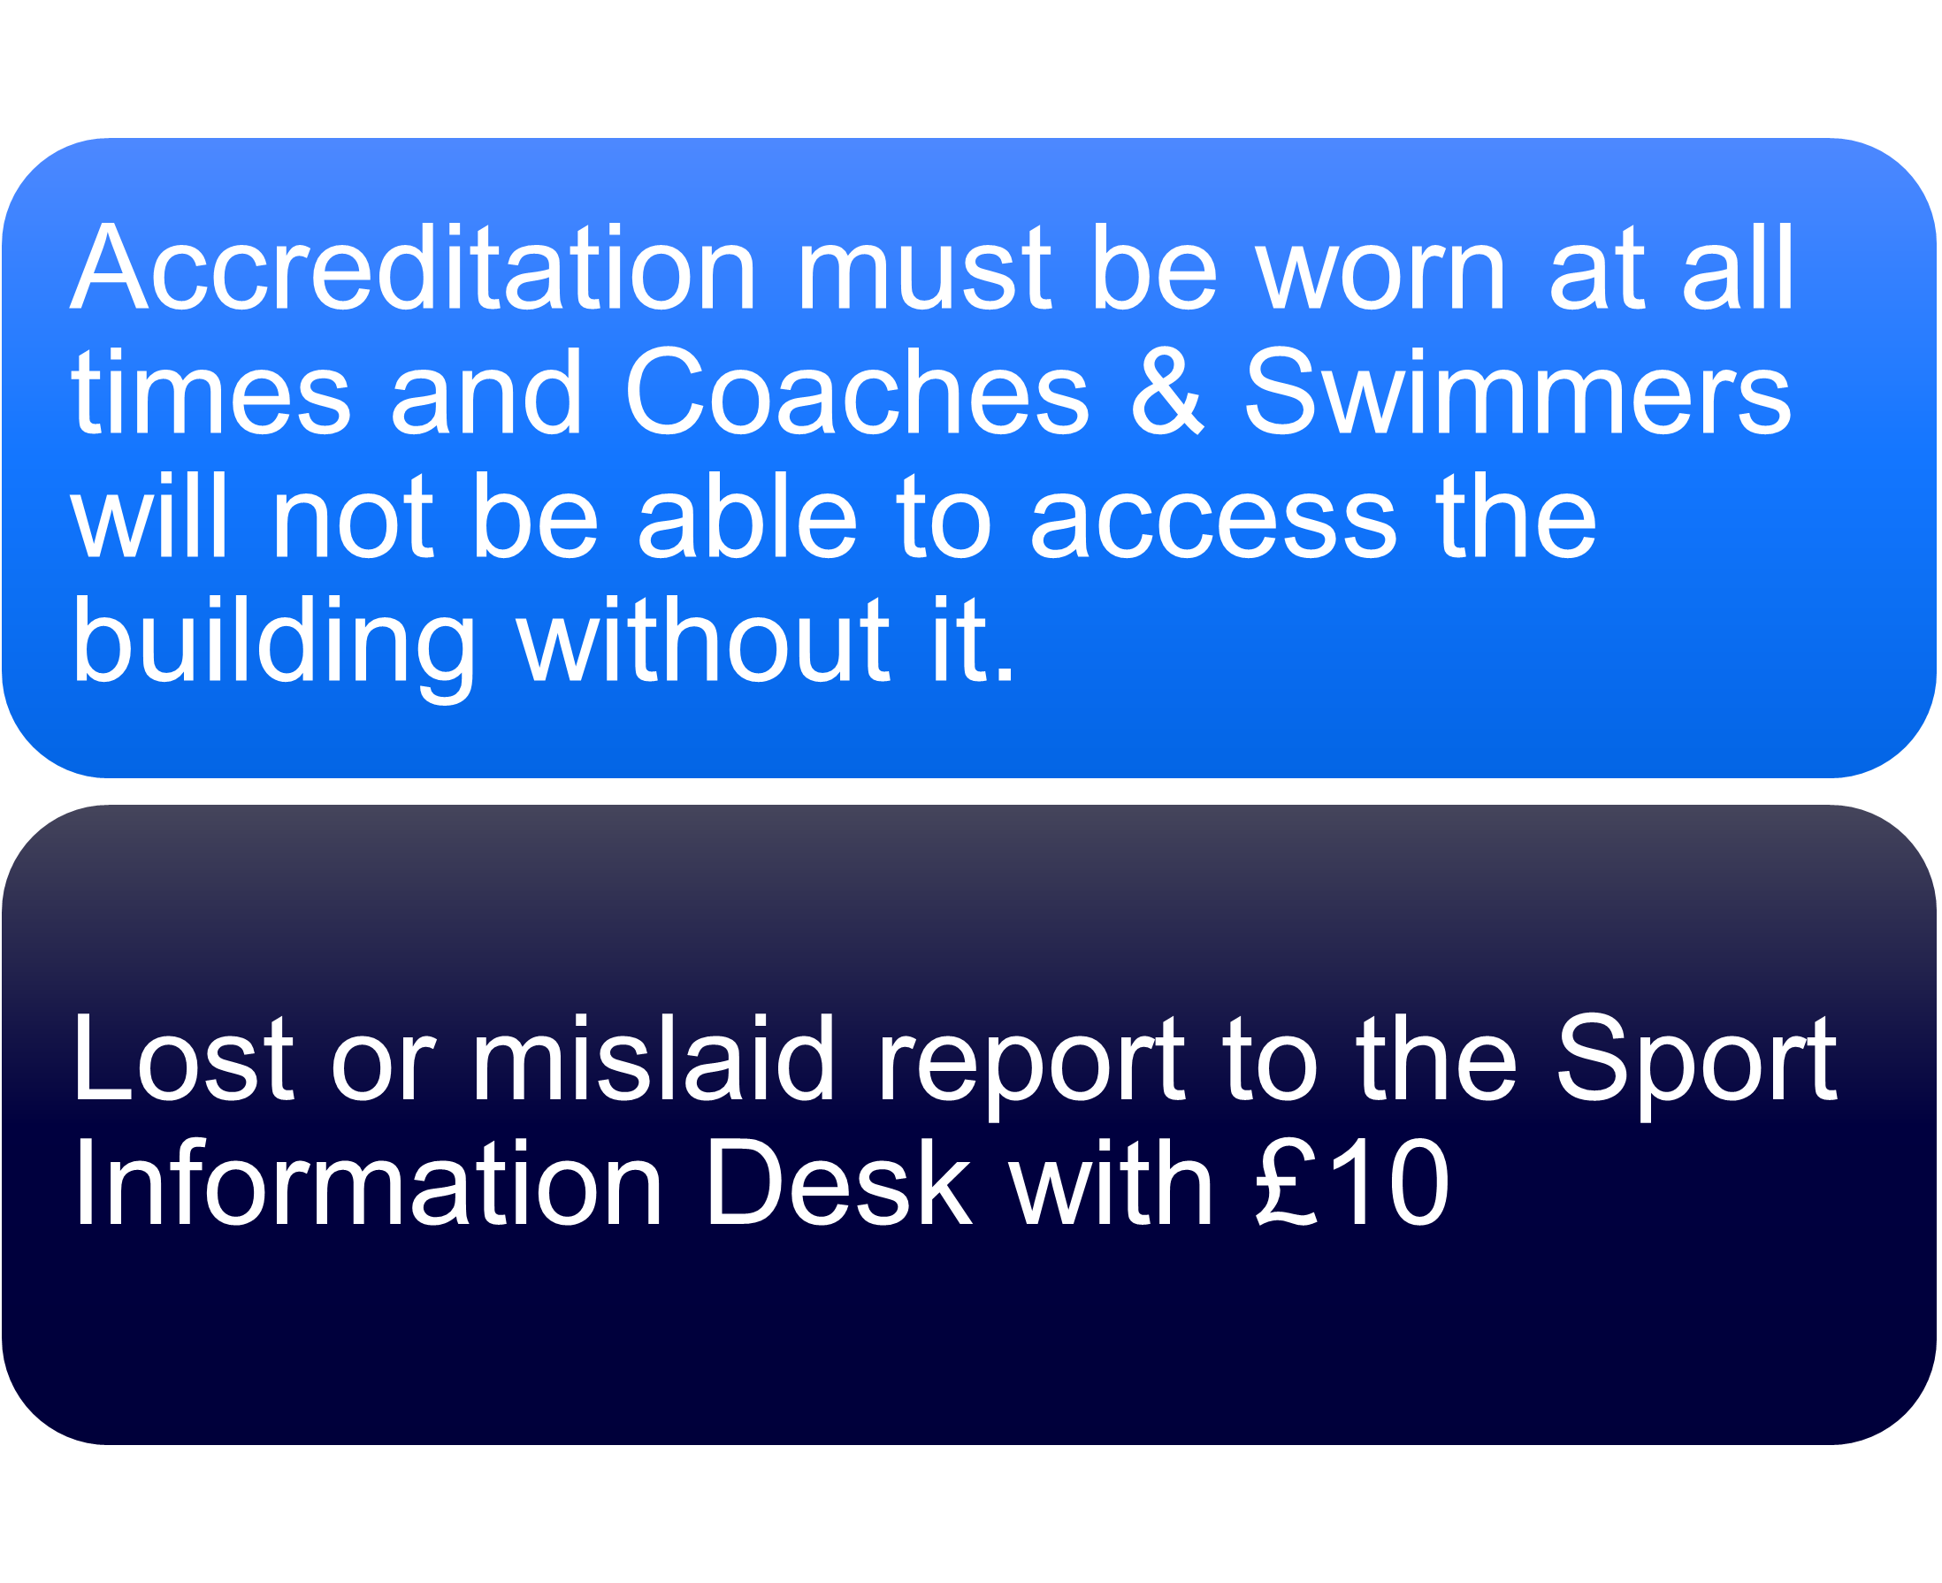
Management team
Management team

Slide 4
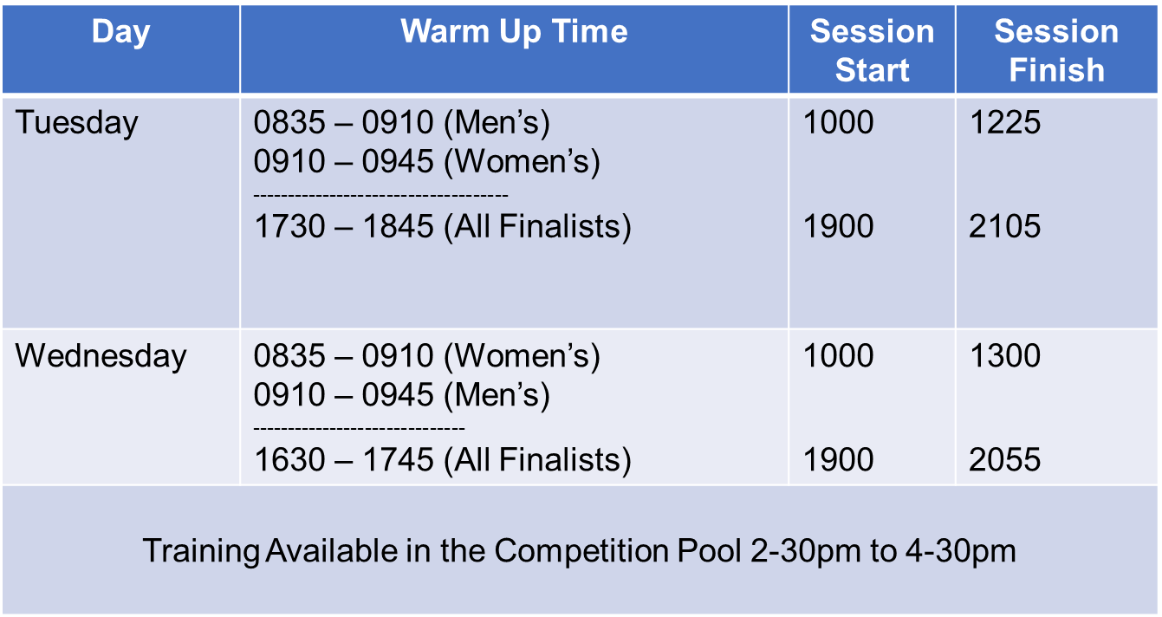
Warm up schedule TUESDAY/WEDNESDAY
Management team
1730

Slide 5
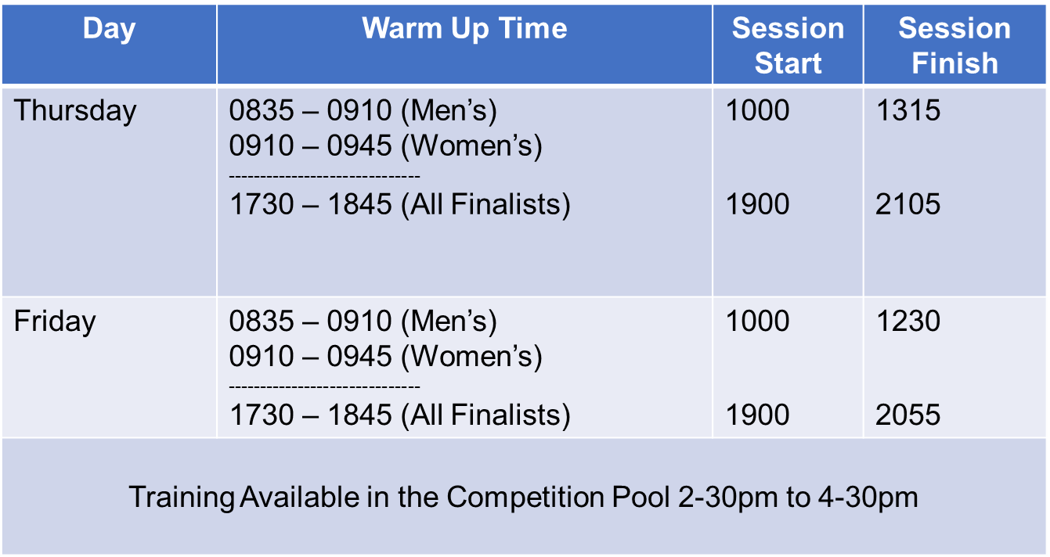
Warm up schedule THURSDAY/FRIDAY
Management team

Slide 6
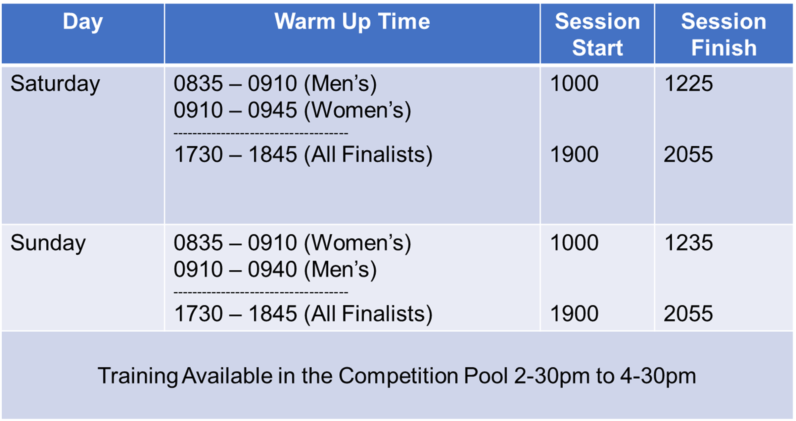
Warm up schedule SATURDAY/SUNDAY
Management team

Slide 7
Training & Warm Up Aids
Management team
Only personal training equipment can be utilised during warm-up and swim down in the competition pool and training pool (pull buoys, kickboards and small hand paddles).
Fins may be used in the training pool only.
The use of bungee cords or large hand paddles is prohibited at all times for safety reasons.

Slide 8
PARA SWIMMING DEVICE CHECKS
Management team
All tapping and starting devices must be prior approved, recorded, and deemed safe for use.
Unapproved devices will lead to disqualification.
An official will be available, outside the Timing Suite, to check equipment 60 minutes before the start of the morning session.

Slide 9
POOL CONFIGARATION
Management team
The majority of starts will be at the opposite end of the pool to the Diving Pit. For all Heats we will be using Lanes 0-9
For Finals we will use Lanes 1-8
As swimmers look down the pool from that end Lane 0 will be to their left
Seeding will be in accordance with WAQUA Swimming Rule SW3.1 with the exception of the 800/1500m Events which will be spearheaded.

Slide 10
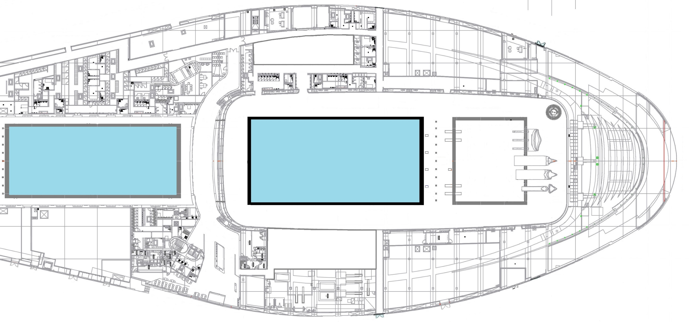
Doping Control
Athlete Medical
Event Office
Call Room
Athlete Changing
50m/150m Call Room
Coaches Pen
Training Pool
100m+ Start End
Competition Pool
50 & 150m Start End
Speedo Retail
Studio
Mixed Zone
Kit Collection
Timing Suite
Cafe
Sport Info Desk
British Swimming Championships
Ground Floor
Entrance

Slide 11
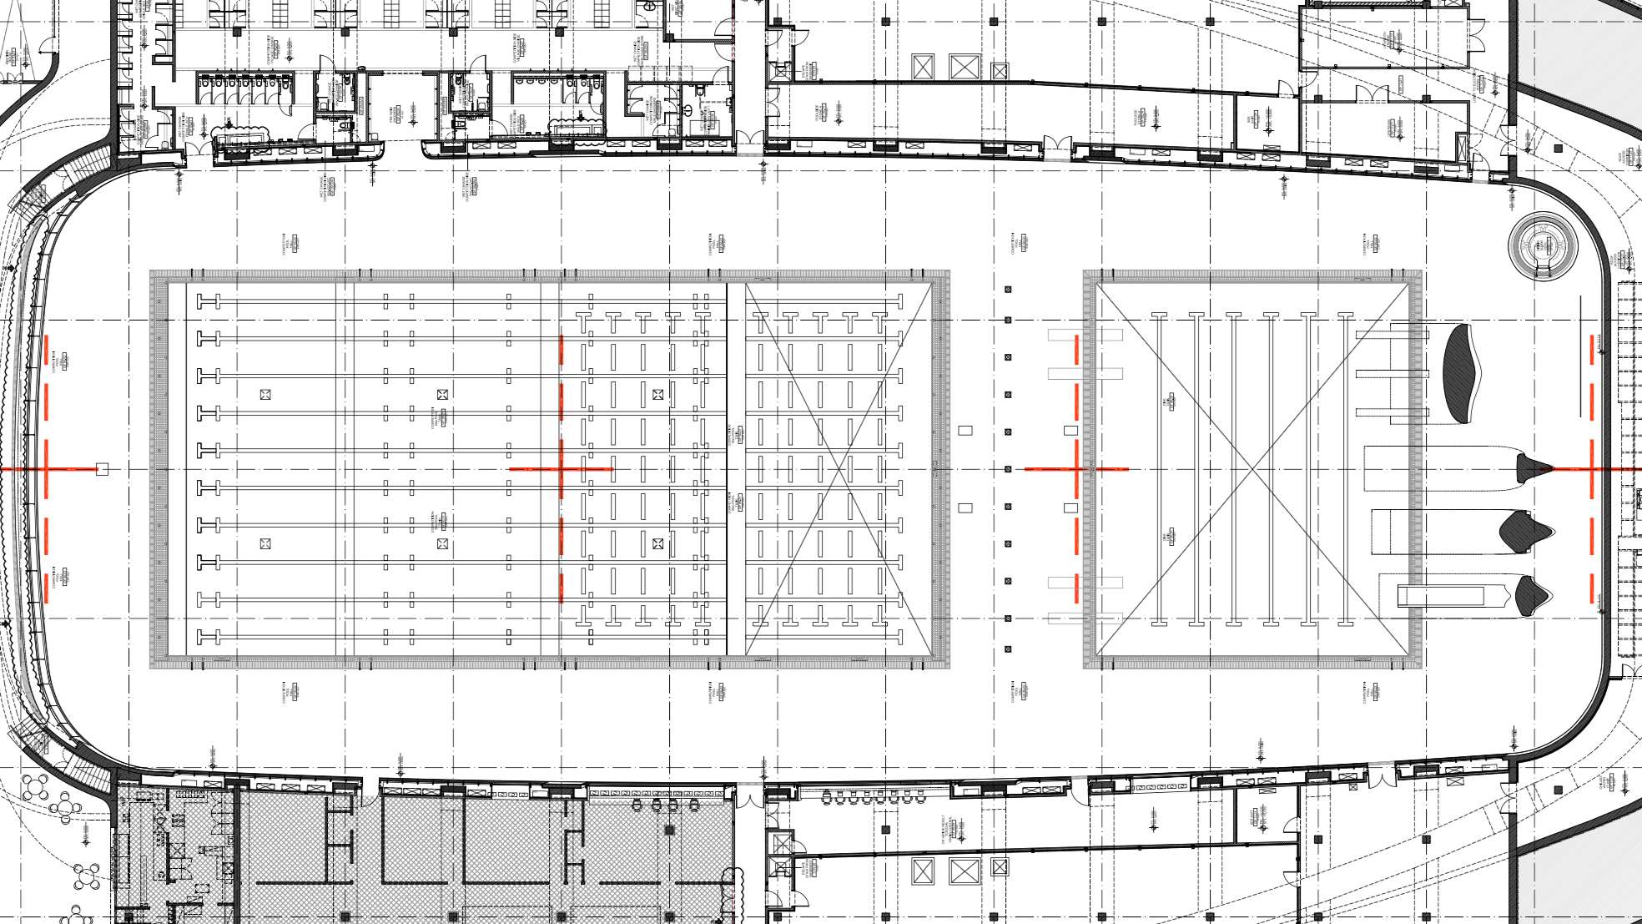
Call Room
50m & 150m Call Room
Coaches Pen
Athlete Prep
POST-RACE FLOW
Studio
Evev8
Mixed Zone
Athlete Kit
Guest Lounge
Timing Suite
Broadcast

Slide 12
Coaches Kiosk/Sport Information Desk
Management team
There will be a kiosk at the Reception Desk in the Foyer.
Start sheets will be available online. There will be no printed Start Lists. QR codes are displayed throughout the building.
Swimmers and coaches must be aware of all announcements and any notices will be available in the coaches’ kiosk.

Slide 13
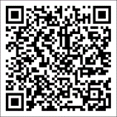
Coaches Kiosk/Sport Information Desk
https://results.swimming.org/swimming/results/2024/AquaticsGBChamps
Management team

Slide 14
Withdrawal from Heats
Management team
Withdrawals must be made by the end of the Team Leader Meeting for day 1 swims, and by 12 noon on the day before for all subsequent days.
Withdrawals must be made electronically.
The Heat Withdrawal Form is here:
https://forms.sportsys.co.uk/british-championships-2024/

Slide 15
Progression from Heats
Management team
Only those competitors who have ‘Great Britain’ as their World Aquatics or World Para Swimming recognised ‘sport nationality’ and will be eligible to represent GB at the following events may progress to any Finals:
2024 Olympic & Paralympic Games
2024 European Junior Championships
The Meet Director and Associate Director Performance Strategy and Operations shall have power to sanction any failure to conform to this.

Slide 16
Non-British Swimmers – Men’s
Management team
Abduljabar | Adama | Mt Kelly | Nigeria
Jad | El Ghaziri | Mt Kelly | Canada
Gideon | Hollinsky | Swansea Uni | Austria
Josh | Kirlew | Enfield Sq | Jamaica
Timothy | Leberl | Beckenham | Mauritius
Denys | Mialkovskyi | RTW Monson | Ukraine
Antonio | Nikolaou | Swansea Uni | Cyprus
Matei | Radu | Plymouth Lea | Romania
Phelipe | Rodrigues | Co Manch Aq | Brazil
Adam | Wilson | Lboro Uni | Ireland
Thomas | Wilkinson | Chesterfield | Ireland

Slide 17
Non-British Swimmers – WOMen’s
Management team
Ekaterina | Avramova | Ealing | Turkey
Lucie | Hanquet | Lboro Uni | Belgium
Claire | Huellou | Plymouth Lea | France
Mariia | Mishchenko | UoAPS | Ukraine
Gaurika | Singh | Camden Swiss | Nepal
Duru | Tanir | Co Cardiff | Turkey
Annabelle | Wilkinson | Chesterfield | Ireland
Katherine | Williams | Wycombe Dist | South Africa

Slide 18
Finals – Olympic Pathway
Management team
There will be Open Paris A & B Finals for all events, with the exception of the 800m & 1500m Freestyle which will be H.D.W. with the fastest heat in the Finals Session.
The fastest eight competitors from the heats (except 800m & 1500m Freestyle) irrespective of age, will be allocated places in the A Final and the next fastest eight in the B Final plus 2 reserves.

Slide 19
Finals – Olympic Pathway
Management team
The next fastest eight eligible Competitors (except 800m & 1500m Freestyle) will be allocated places in the following final.
Junior Final: Male/Female born 06-10
A competitor in a Junior Final may also be a reserve in the Open Finals and will be moved to the Open Finals as necessary
The priority order for any athlete eligible to compete in any final will be the
Open A Final, Open B Final, Junior Final

Slide 20
Finals – Para MC Events
In specified events, the ten highest points scoring Para Competitors shall be allocated places in the Paris Para MC Final otherwise the eight highest points scoring competitors shall be allocated places.
It is not anticipated that there will be any 10 lane finals.
Management team

Slide 21
ORDER OF FINALS
Management team
Junior Final
Open B Final
Paris Para MC Final
Open Paris Final

Slide 22
Withdrawal from Finals
Management team
Finalists and reserves, not wishing to swim, shall notify the Chief Recorder of their intention to withdraw no later than 30 minutes after the conclusion of the last event in the Session in which they have qualified for the next round
Withdrawals must be made electronically.
The Finals Withdrawal Form is here:
https://forms.sportsys.co.uk/british-championships-2024/
Reserves will be released upon publication of the Finals session start lists.

Slide 23
Call Room – Heats & Finals
Management team
Competitors must report to the competition stewards in the call room for heats and finals and follow their direction.
It is athlete’s responsibility to report in sufficient time to be available to parade for their event
Upon entry, the athlete must ensure that they report to a Steward and be registered as being present in the Call Room.

Slide 24
Call Room – Heats & Finals
They must enter the Call Room ‘race ready’ as under normal circumstances having entered the Call Room they should remain in its confines until lead onto the pool deck for their race.
Coaches/chaperones will not be allowed in the call room area at any time unless they have a recognised code of exception for those athletes on the Paralympic pathway.
Management team

Slide 25
Finals Timelines
Management team
Timelines for the Finals Sessions are available online and at the Sport Information Desk.
These show the time each Final is due to start.
It is not the reporting time.
Swimmers need to ensure that they are in the Call Room area in good time.
Suggest 15 minutes before the race start time

Slide 26
Streaming, Media, Mixed Zone
Management team
All sessions will be live streamed and televised.
It is essential that you ensure that swimmers use the Changing Rooms to get changed – not on the Athlete Seating Area.
Swimmers should wear Club Kit when introduced for races.
It is intended to carry out, subject to the approval of the swimmer, live post-race interviews after each Open Final.
There will also be other Media in the Mixed Zone

Slide 27
Presentations
Management team
There will be a presentation to the swimmers placed first, second & third in the Open A Final.
There will be a presentation to the swimmers placed first, second & third on Para Points across all Finals.
Presentations will take place immediately after each final.

Slide 28
Doping
Management team
Swimmers are warned that random doping control may take place during these championships.
Please ensure that competitors bring with them either a Passport or other form of identity incorporating their photograph.

Slide 29
FOOTBALL
Management team
West Ham vs Tottenham Hotspur
Tuesday 2nd April 8-15pm
Please leave immediately after the end of the Finals Session.

Slide 30
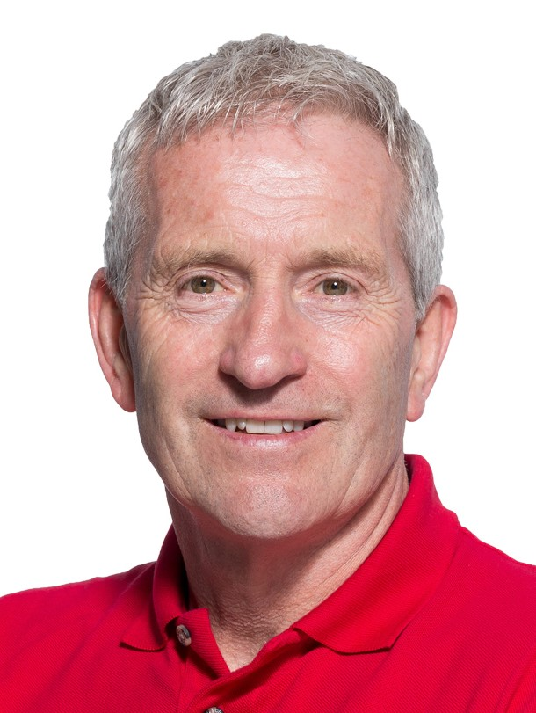
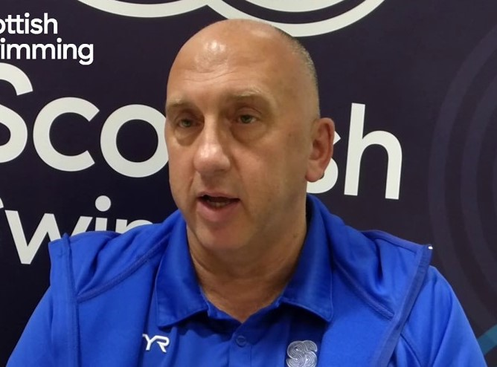
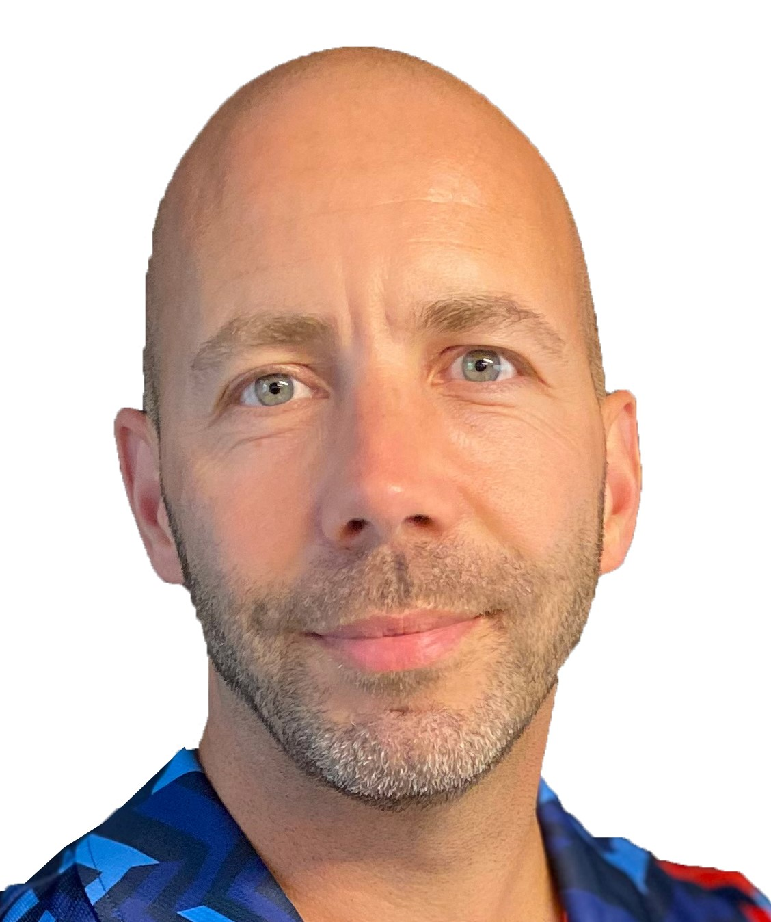
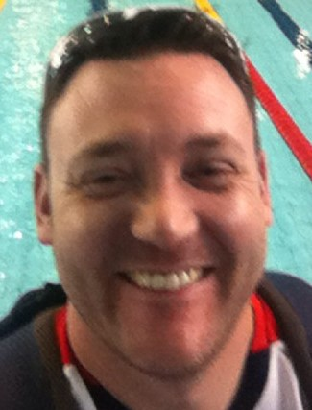
COACHES MEETING AFTER HEATS ON SATURDAY – ALL WELCOME
OLYMPIC AND PARALYMPIC
HEAD COACHES
Hosted by Alan Lynn in Guest Lounge

Slide 31
Good luck to all the swimmers and thank you to their coaches
aquaticsgb.com
info@aquaticsgb.com
01509 618700

Slide 32
Summer Championships 2024
Aquatics GB Summer Championships 2024
Ponds Forge International Sports Centre, Sheffield
Saturday 20th – Friday 26th July
Scotland – Aberdeen 11th – 14th July
England – Sheffield 29th July – 3rd August
Wales – Swansea 1st – 5th August
Management team

Slide 33
Thank you
aquaticsgb.com
info@aquaticsgb.com
01509 618700

